Slide 1
The Theory and Development of Programming Languages
Valentin Ornelas
Institute for Computing in Research
Summer 2021

Slide 2

Motivation
I got in to programming fairly recently
Good way to relax after a long day
The current world is dependent on programming languages
Best to learn how a language works under the hood
Notes:
the topic of programming languages is one that is very close to my heart. Although I just started programming recently I have found that it is a great way to relieve stress or just give me some thing to think about when I’m bored. But, I wasn't content with just programming and felt that it was best to learn how a language works under the hood
global: the reason that the general world would should know more about how a programming language works is because the current world is dependent on programming languages and if you are going to be dependent on something you should at the very least know the basics of how it works

Slide 3
Project Plan
take the basic information that is often taught at high level college courses and convert it into something that can be understood by a high school student

Slide 4
Grammar
Grammar in the brain is almost built in.
We automatically look for grammar rules in any language.
How do computers understand grammar
Notes:
Grammar in the brain is almost built in. sure it needs to be studied but we do automatically look for grammar rules in any language. So we know how humans understand grammar but how do computers understand it, to answer that I am going to have to first teach 2 crucial terms.

Slide 5

The Jargon

Slide 6
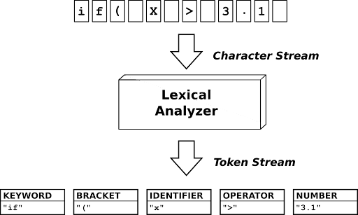
Lexical analysis
when the computer looks at the character’s that the user enters and converts them into “TOKENS” that the computer can recognize and use for its operations.
This is how you get characters or keywords that do specialized things in a language

Slide 7
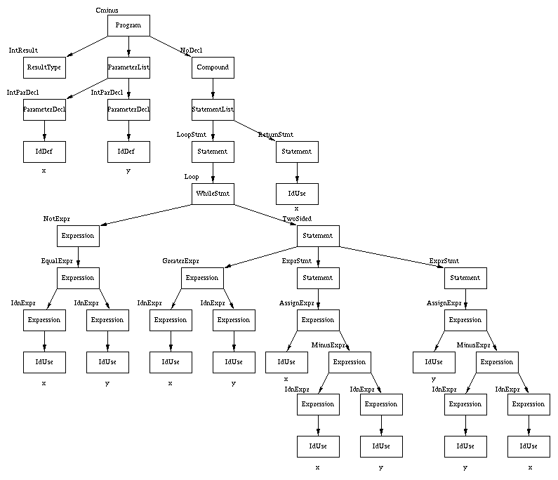
Syntax analysis
when the computer uses the tokens that it got from the lexer and converts that into the grammar of the languages using a syntax tree (seen to the side ->)

Slide 8
Methods
YouTube tutorial
Articles

Slide 9
My contribution
Built in functions
    Prime
    RR
    Bee
Changed grammar

Slide 10
Valley Speak
Screen recording here
Notes:
Now that we have gone trough what the computer needs to follow grammar the best way to explain how it works is with an example

Slide 11

Questions
Any Questions (mark)

Slide 12
Acknowledgments
Thank you to the following people
Rhonda Crespo
Mark Galassi
Jason Schaefer
The software freedom conservancy
Everyone else at the institute who helped me achieve my end goal

Slide 13
References
https://www.businesshorsepower.com/wp-content/uploads/2014/11/questionmark.png
http://quex.sourceforge.net/
https://ecee.colorado.edu/~waite/Darmstadt/corg.html
https://www.youtube.com/playlist?list=PLZQftyCk7_SdoVexSmwy_tBgs7P0b97yD

